Slide 1
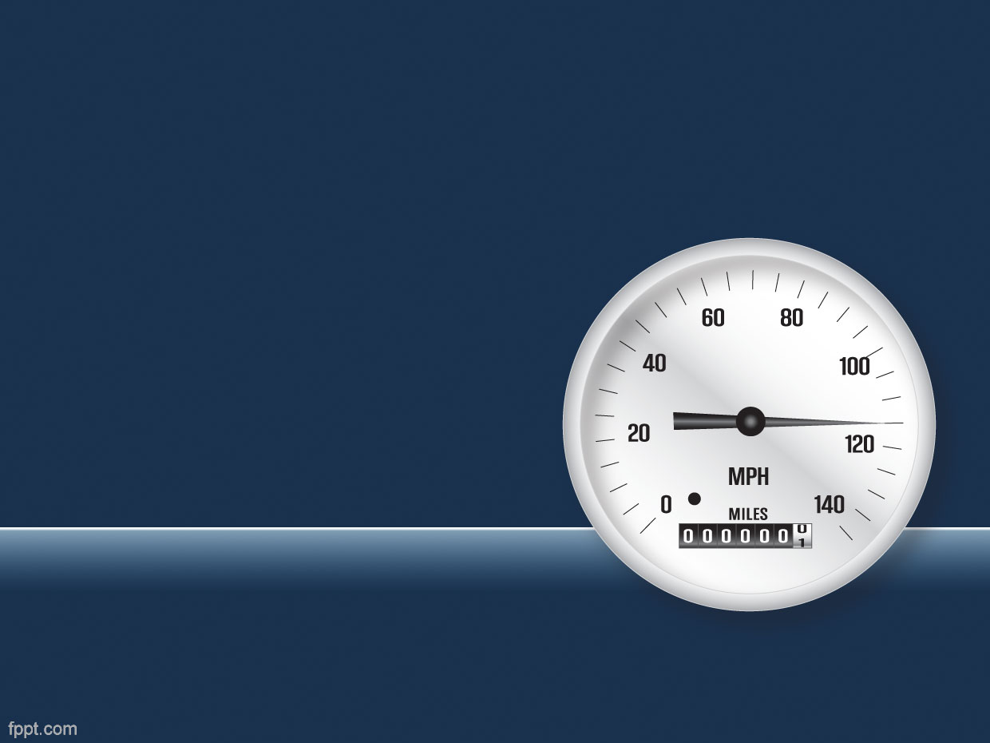
SPEEDOMETER
Presented By:
Muhammad Ahmad
Nimra Amer
Farheen Akmal

Slide 2
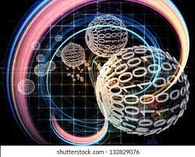
Outline
Registers
Adder & Subtractor
Seven Segment Decorder
Conclusion

Slide 3
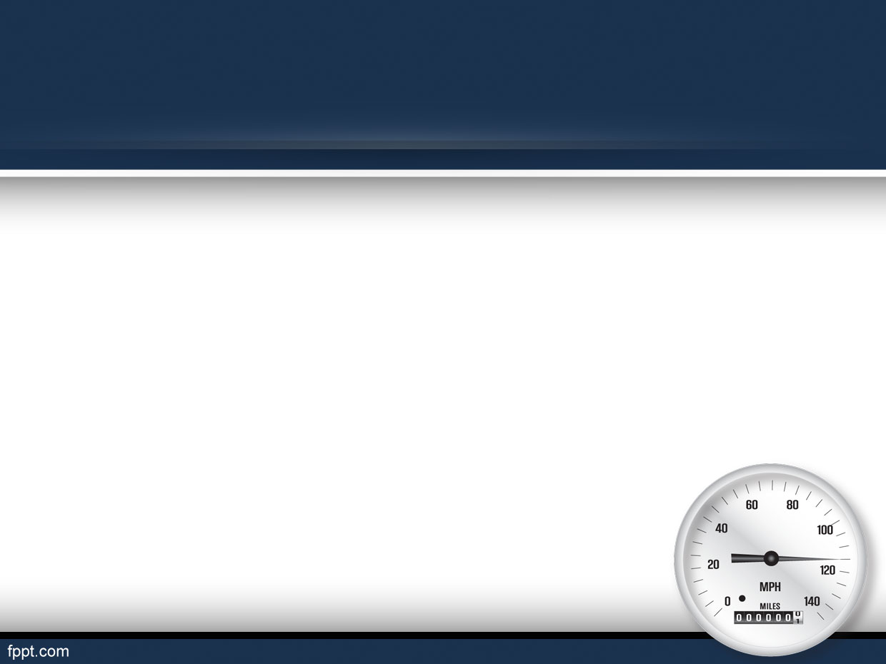
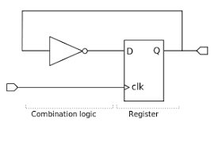
Registers
It is used to store value after passing through multiple if statements
Example:
Acceleration
Fast acceleration
Break
All off

Slide 5
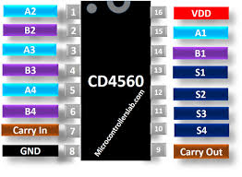
Adder
It simply add the values coming from registers
Acceleration == increase by 2
Fast acceleration == increase by 6

Slide 6
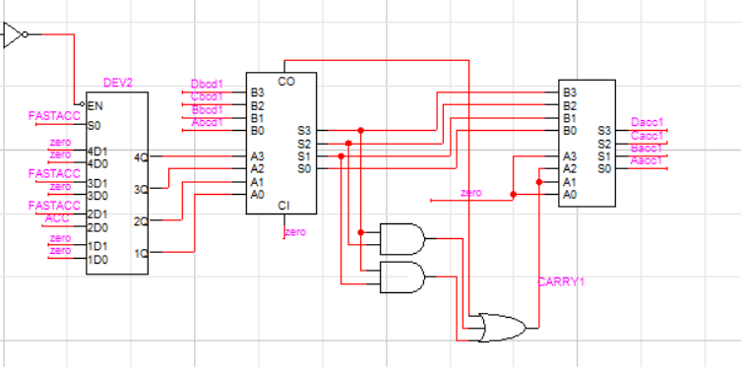

Slide 7
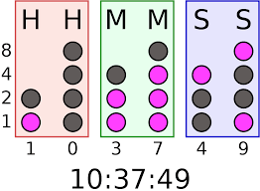
Subtractors
We have used six subtractors
Three for minus 1
Three for minus 6
All off == decrease by 1
Break == decrease by 6

Slide 8
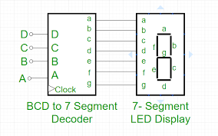
Seven Segment Decoder
It simply decodes the values coming from the data and show on seven segment display

Slide 9
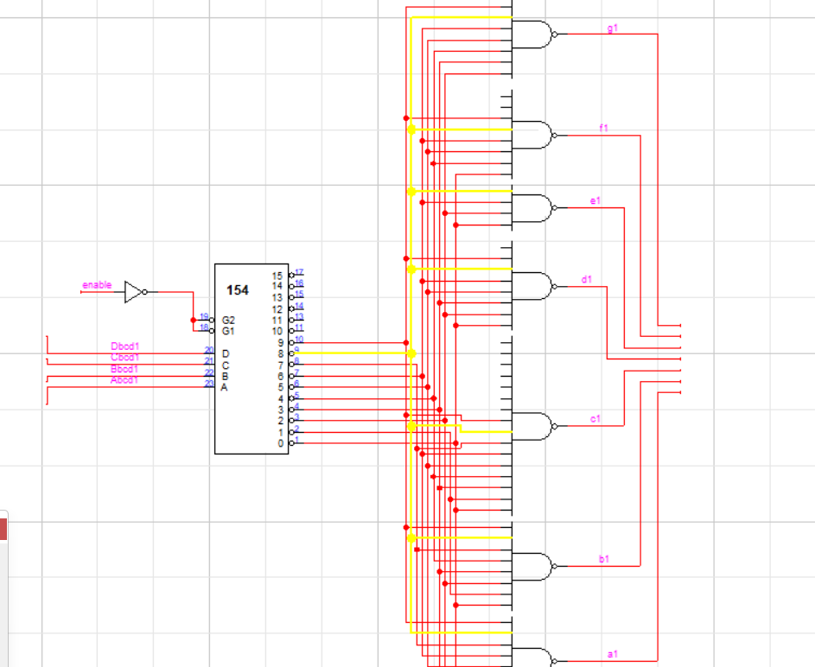

Slide 10
Conclusion
Firstly the data is stored in registers according to suitable conditions.
Secondly apply breaks or acceleration
Thirdly decrease or increase the values accordingly.
At last after applying all the necessary actions the final result goes to seven segment display.

